Slide 1
Micro-Credit Defaulter Model
Submitted by:
Bishwajit Bhattacharya

Slide 2
ACKNOWLEDGMENT
I take Data from “internshipfliprobo.xlsx”. I taken the help from “A Complete Machine Learning Project Walk-Through in Python” bye William Koehrsen.

Slide 3
INTRODUCTION
A Microfinance Institution (MFI) is an organization that offers financial services to low income populations. MFS becomes very useful when targeting especially the unbanked poor families living in remote areas with not much sources of income. The Microfinance services (MFS) provided by MFI are Group Loans, Agricultural Loans, Individual Business Loans and so on.
Many microfinance institutions (MFI), experts and donors are supporting the idea of using mobile financial services (MFS) which they feel are more convenient and efficient, and cost saving, than the traditional high-touch model used since long for the purpose of delivering microfinance services. Though, the MFI industry is primarily focusing on low income families and are very useful in such areas, the implementation of MFS has been uneven with both significant challenges and successes.
Today, microfinance is widely accepted as a poverty-reduction tool, representing $70 billion in outstanding loans and a global outreach of 200 million clients.
In data set the target columns is ‘label’ which has integer value so we will apply classification technique.

Slide 4
Data Cleaning
Contrary to what most data science courses would have you believe, not every dataset is a perfectly curated group of observations with no missing values or anomalies (looking at you mtcars and iris datasets). Real-world data is messy which means we need to clean and wrangle it into an acceptable format before we can even start the analysis. Data cleaning is an un-glamorous, but necessary part of most actual data science problems.
import pandas as pd
import numpy as np
import seaborn as sns
df = pd.DataFrame(pd.read_excel("internshipfliprobo.xlsx"))
Df
Total data set has 209593 rows and 37 columns. First we need to check is there any null value, also we need to check what is the data type of the data set.

Slide 5
df.isnull().sum()
there is no null value on dataset.
Df.dtypes
There is mixed of float, int and object type dataset

Slide 6
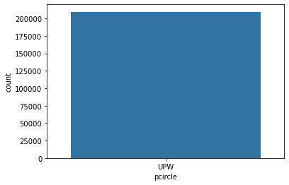
Data Visulization
Making DataFrame for the Nominal Data

Slide 7
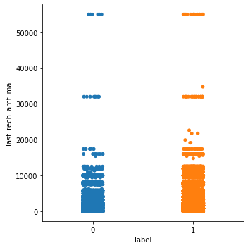
Making dataframe of the ordinal data.

Slide 8
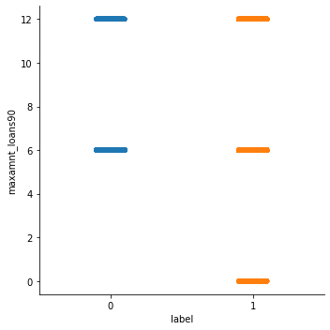

Slide 9
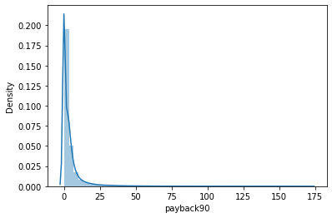
Checking the distribution of the continuous value of the float type columns

Slide 10
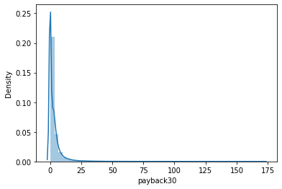

Slide 11
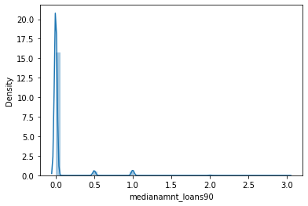

Slide 12
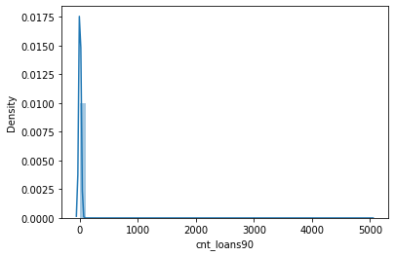
Since the dataset has a lot of string values. We will use the encoding techniques to convert the string data to numerical one

Slide 13
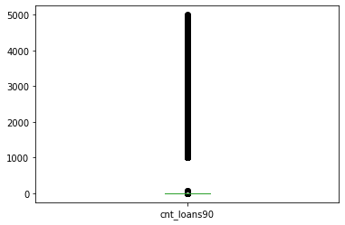
Encoding of DataFrame:¶
import sklearn
from sklearn.preprocessing import OrdinalEncoder
enc=OrdinalEncoder()
for i in df.columns:
if df[i].dtypes=="object":
df[i]=enc.fit_transform(df[i].values.reshape(-1,1))
Outliers Check:

Slide 14
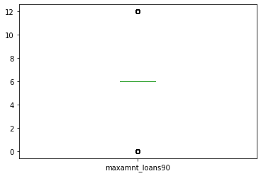

Slide 15
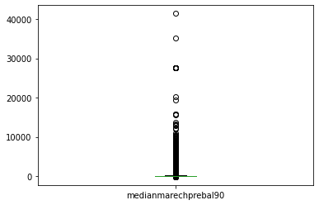

Slide 16
Autometic Outlier Removal
from sklearn.model_selection import train_test_split
from sklearn.linear_model import LinearRegression
from sklearn.neighbors import LocalOutlierFactor
from sklearn.metrics import mean_absolute_error
data = df.values
X, Y = data[:, :-1], data[:, -1]
X_train, X_test, Y_train, Y_test = train_test_split(X, Y, test_size=0.33, random_state=1)
print(X_train.shape, Y_train.shape)
(140427, 35) (140427,)

Slide 17
lof = LocalOutlierFactor()
yhat = lof.fit_predict(X_train)
mask = yhat != -1
X_train, Y_train = X_train[mask, :], Y_train[mask]
print(X_train.shape, Y_train.shape)
(138465, 35) (138465,)
model = LinearRegression()
model.fit(X_train, Y_train)
LinearRegression()

Slide 18
yhat = model.predict(X_test)
mae = mean_absolute_error(Y_test, yhat)
print('MAE: %.3f' % mae)
MAE: 0.000
dataloss=((140427-138465)/140427)*100
dataloss
1.3971672114336986
data loss is less than 10 so we can go ahead.

Slide 19
Target and Features
features=df.drop("label",axis=1)
target=df["label"]
x=features
y=target
Target is intejer so we will consider classification techniques

Slide 20
Classification Technique
I used adaboost classifier(),knn classifier() , dtc classifier() and svc()
I got 90% accuracy on adaboost 86% on dtc, 87% on svc and 86% on knn.
So the best model is adaboost

Slide 21
Model
I create a joblib name of micro.obj and a pickle file name pickleadfile.pkl.
I done with cross validation score , mean median and also kfold matrics.
Model is giving 90% accuracy so it is good to go.

Slide 22
Conclusion :
So as per my model mfi can gave 90% accuracy, which is quite good enough to process.

